Slide 1
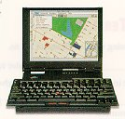
Reference: Peter Norton’s® Introduction to Computers
But first – see the book of lists
The Amazing Computer
WOW!

Slide 2
Learning Objectives:
List at least five professions in which computers are routinely used, and describe at least on of the ways computers have affected the work of people in those professions.
List the four parts of a computer system.
Identify four kinds of computer hardware.
List the two major categories of software and explain the purpose of each.
List the four most common types of computers available today and describe what kind of job each does best.

Slide 3
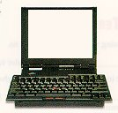
Computer - an electronic device used to process data.
abcde

Slide 4
Computer System:
  Hardware - physical parts of the computer
  Software - instructions to the computer
  Data - raw facts the computer can manipulate
  People - also known as users

Slide 5
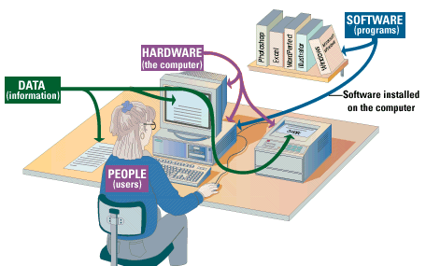

Slide 6
Computer Hardware - any part of the computer you can touch.
  Processor
  Memory
  Input and Output Devices
  Storage Devices

Slide 7
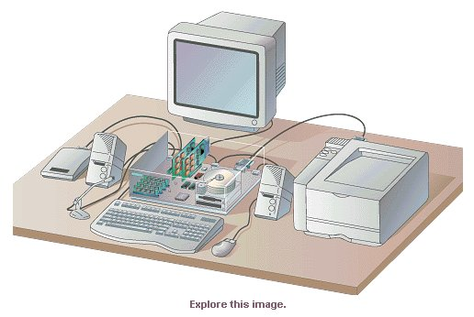
Some types of hardware devices.
Output
Processor
Memory
Input and
output
Storage
Input

Slide 8
Software - electronic instructions to the computer. Also referred to as a “program.”
Two types:
  System Software
  Application Software

Slide 9
System Software:
  Operating Systems (name them)
  Disk Utilities

Slide 10
Application Software:
  Word Processing
  Spreadsheets
  Graphics
  Databases
  Entertainment
  Educational
  Communications
  Presentation

Slide 11
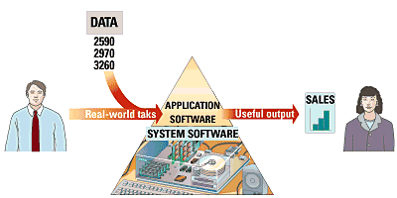
Application software and system software
work together to provide useful output.

Slide 12
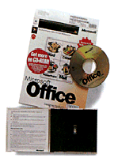
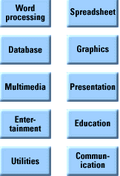
Software brings a computer to life.

Slide 13
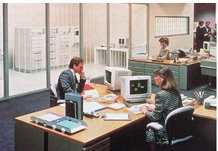
Types of Computers:
Supercomputer
Mainframe
Minicomputer
Microcomputer
Mainframe computer

Slide 14
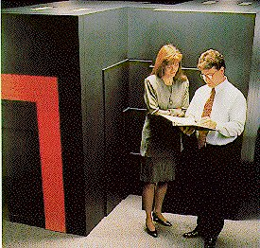
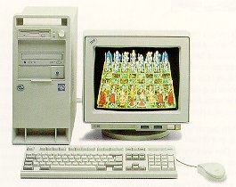
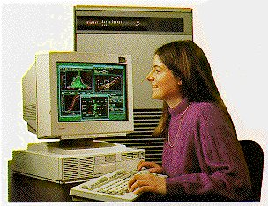
Microcomputer
Supercomputer
Minicomputer

Slide 15
What is Information Technology
Fusion of computer and communication technology
Computer Technology
  programmable, multiuse machine that accepts data and processes it into usable information
    summaries, totals, or reports
  used to speed up problem solving and increase productivity.

Slide 16
What is Information Technology
Communication Technology
  consists of electromagnetic/optical devices and systems for communicating over long distances
InfoTech or IT is any technology that helps to produce, manipulate, store, communicate, and/or disseminate information
merges computing with high-speed communications links carrying data, sound, and video

Slide 17

How have you been using communication Technology in your life?

Slide 18
List some other uses of
  Computer Technology
  Communication Technology

Slide 19
The Computer Defined
A device that computes
Electronic device
Converts data into information
Modern computers are digital
  Two digits combine to make data (1s and 0s)
Older computers were analog
  A range of values made data

Slide 20
Communication Defined
  Communication: To transfer data/information from one point to another
    Using Wires
      Electrical Signals
      Optical Signals (Light)
    Wirelessly
      ElectroMagnetic Waves
      Acoustic Waves (Sound) ….?
    Using Analog Signals
    Using Digital Signals

Slide 21
Related IT terms
What is a Network?
  communications system connecting two or more computers with/without wires
What does being online mean?
  using a computer or other information device, connected through a voice or data network, to access information and services from another computer or information device

Slide 22
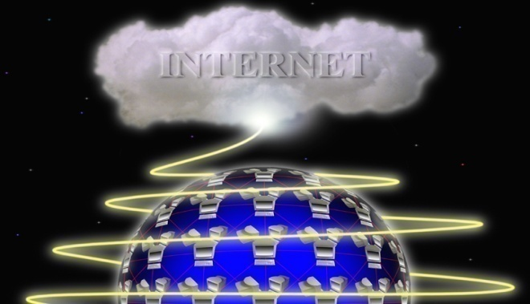
Related IT terms
Cyberspace
  encompasses the whole wired and wireless world of communications
The Internet
  the “network of all networks”
Multimedia
  technology that presents information in more than one medium, such as text, still images, moving images, and sound
World Wide Web
  “graphical side of the Internet”
  global network of linked documents on the Internet

Slide 23
Related IT terms
The E-word ; E Stands for Electronic
  E-mail
  E-learning
  E-business
  E-commerce
  E-government

Slide 24
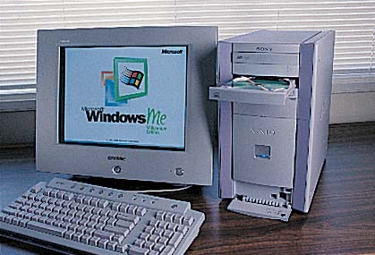
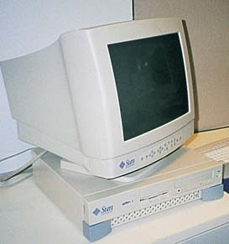
Computers For Individual Use
Desktop computers
  The most common type of computer
  Sits on the desk or floor
  Performs a variety of tasks
Workstations
  Specialized computers
  Optimized for science or graphics
  More powerful than a desktop
Notes:
Insider information
System units are commonly called cases. Many computer enthusiasts customize or ‘mod’ their cases with windows and lights. See www.casemodgod.com for examples of cases and products.
Sun Microsystems makes the most popular workstations on the planet. Sun’s systems are used in diverse applications such as medical imaging and CGI (computer generated image) animation.

Slide 25
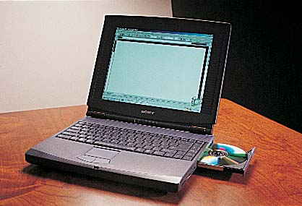
Computers For Individual Use
Notebook computers
  Small portable computers
  Weighs between 3 and 8 pounds
  About 8 ½ by 11 inches
  Typically as powerful as a desktop
  Can include a docking station

Slide 26
Contrast desktop and notebook computers. Focus on the pros and cons of each type of computer.

Slide 27
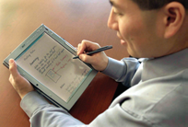
Computers For Individual Use
Tablet computers
  Newest development in portable computers
  Input is through
  a pen
  Run specialized versions of office products
Notes:
The tablet PC was designed to simulate a piece of paper. Users interact with the tablet as if it was an unlimited paper notebook.
For more information
See www.microsoft.com/windowsxp/tabletpc/evaluation/tours/default.mspx for an example of the Tablet PC in action.

Slide 28
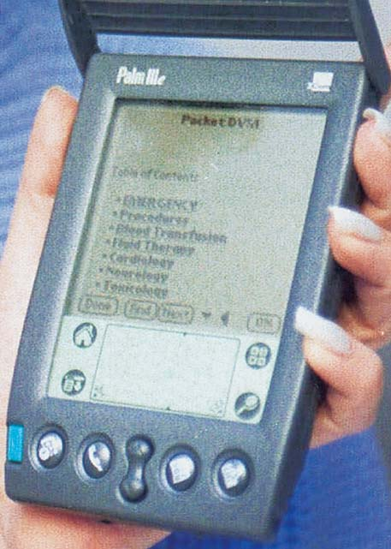
Computers For Individual Use
Handheld computers
  Very small computers
  Personal Digital Assistants (PDA)
  Note taking or contact management
  Data can synchronize with a desktop
Smart phones
  Hybrid of cell phone and PDA
  Web surfing, e-mail access
Notes:
Refer to productivity tip on page 13. This tip helps the student determine what type of PC is best for them.

Slide 29
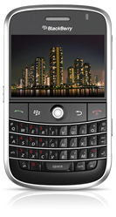
Smart Phone: Black Berry
Features
  Phone
  IM
  Internet (Email, Browsing)
  Camera
  Video Recording

Slide 30
Computers For Organizations
Network servers
  Centralized computer
  All other computers connect
  Provides access to network resources
  Multiple servers are called server farms
  Often simply a powerful desktop

Slide 31
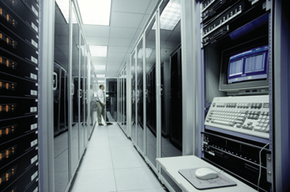
Computers For Organizations
Mainframes
  Used in large organizations
  Handle thousands
  of users
  Users access through a terminal
    Dumb Terminal
    Intelligent Terminal

Slide 32
Computers For Organizations
Minicomputers
  Called midrange computers
  Power between mainframe and desktop
  Handle hundreds of users
  Used in smaller organizations
  Users access through a terminal

Slide 33
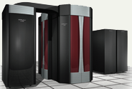
Computers For Organizations
Supercomputers
  The most powerful computers made
  Handle large and complex calculations
  Process trillions of operations per second
  Found in research organizations
Notes:
understanding trillions of calculations -- A simple explanation is to add 1 trillion random numbers together in a second. Contrast the speed of a super computer to the fastest desktop computer advertised during the week of class.

Slide 34
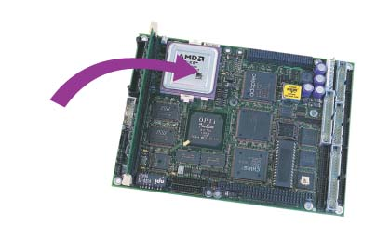
Specialized Computers
Microcontrollers
  also called embedded computers.
  tiny, specialized microprocessors installed in “smart” appliances and automobiles.

Slide 35
Computers Everywhere
Not just Desktops, Workstations, Tablet PCs, Handheld PCs (PDAs), Servers, Mainframe computers, Minicomputers
But also…
  Cell phones
  Alarm Clocks
  Microwave Ovens
  Lighting control in a building
  Washing Machines

Slide 36
Computers In Society
More impact than any other invention
  Changed work and leisure activities
  Used by all demographic groups
Computers are important because:
  Provide information to users
  Information is critical to our society
  Managing information is difficult

Slide 37
Generate a list of ways the computer/IT has impacted the world.
  Include both positive changes and negative changes.
  think creatively.

Slide 38
How difficult would it be to live without computers?

Slide 39
Computers In Society
Computers at home
    Business
    Entertainment
    Communication
    Education
Notes:
Insider information
The 2000 Census determined that 51% of American households had computers. Over 42% of these households also had Internet access. This can be contrasted to 36% and 18% in 1997. See www.census.gov/prod/2001pubs/p23-207.pdf for more information.

Slide 40
Computers In Society
Computers in education
  Computer literacy required at all levels
Computers in small business
  Makes businesses more profitable
  Allows owners to manage
Computers in industry
  Computers are used to design products
  Assembly lines are automated
Notes:
Insider information
Specialized mountain bikes are designed on Sun workstations.

Slide 41
Computers In Society
Computers in government
  Necessary to track data for population
    Police officers
    Tax calculation and collection
  Governments were the first computer users
Notes:
Most state departments of motor vehicles rely on a mainframe computer. Officers access the mainframe from a remote intelligent terminal.

Slide 42
Computers In Society
Computers in health care
  Revolutionized health care
  New treatments possible
  Scheduling of patients has improved
  Delivery of medicine is safer
Notes:
Page 19 of the text introduces the first Norton Notebook, the Merging of Media and Meaning. The author draws an analogy between electricity and computers in our lives. Discuss how difficult live would be without either of these devices. Remember that computers exist in nearly all of our modern devices, including cars, phones, kitchen appliances and entertainment devices.

Slide 43
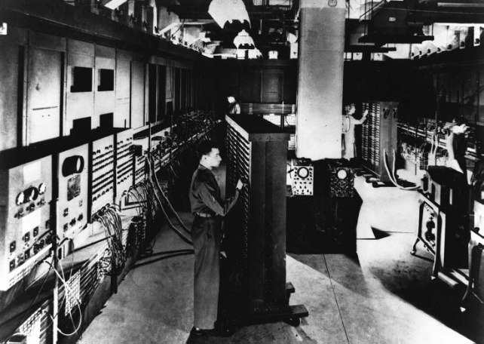
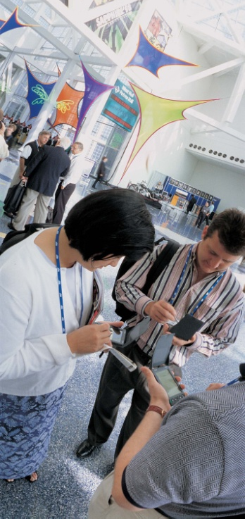
Where Is Information Technology Headed?
Three Directions of Computer Development
Miniaturization
Speed
Affordability
Then (1946)
Now
Notes:
1946 ENIAC (Electronic Numerical Integrator And Calculator) vs. today’s handheld PDA
Today’s PDA is far smaller, faster, and more affordable than the ENIAC.

Slide 44
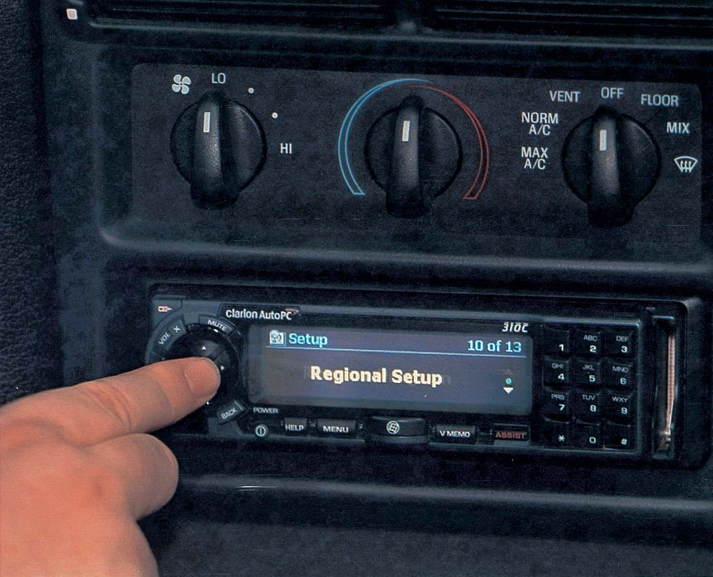
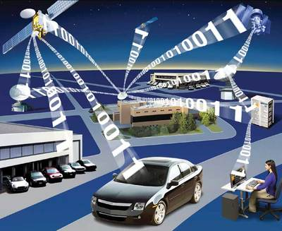
Where Is Information Technology Headed?
Three Directions of Communication Development
Connectivity
Interactivity
Multimedia
Auto PC
Image Courtesy: http://blog.wired.com/cars/images/2007/05/31/telematics.jpg
Notes:
Connectivity - the ability to connect computers to one another by communications line, so as to provide online information access.
Interactivity - two-way communication in which a user can respond to information he or she receives and modify the process.
Multimedia - technology that presents information in more than one medium--such as text, pictures, video, sound, and animation--in a single integrated communication.

Slide 45
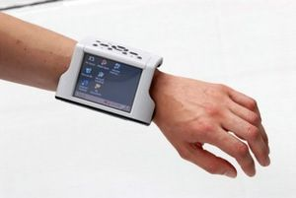
When Computers & Communications Combine:
Convergence, Portability, & Personalization
Convergence
Portability
Personalization
Image courtesy: http://en.wikipedia.org/wiki/Wearable_computer
Notes:
Convergence - the combining of several industries through various devices that exchange data in the format used by computers. The industries are computers, communications, consumer electronics, entertainment, and mass media.
Portability- wearable computer on model in picture.
Personalization - the creation of information tailored to your preferences, such as stock portfolio information kept on Yahoo.com’s Web site.

Slide 46
What should be the next Technology?
  What can be the applications of that technology?
  Your own ideas/thoughts

Slide 47
Moving on to Computer…

Slide 48
What is a computer?
a device that computes
Processing /
Computation
Input
Output

Slide 49
What is Processing?
Conversion of Data into Information
Data
  The raw facts and figures that are processed into information
Information
  Data that has been summarized or otherwise manipulated for use in decision making

Slide 50
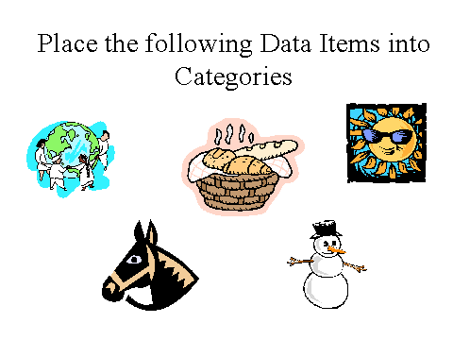
Notes:
Potential categories could include Animals vs. Objects, Edible Items vs. Inedible Items, Multiple Items vs. Single items

Slide 51
Types of Data
Numeric
  Record Daily Milk Expenses
    Sun 20 Rs
    Mon 30 Rs
    Tues 35 Rs
    Wed 23 Rs
    Thurs 34 Rs
    Fri 50 Rs
    Sat 30 Rs

Slide 52
Types of Data
Numeric
  Processing Data
    Finding Weekly expenditure on Milk
    Finding a Daily Average of milk expenditure
Find Total/Average
20,30,35,23,
34,50,30
222/31.7

Slide 53
Types of Data
Text
  Raw:
  one of the most important concepts students must understand is the fundamental difference between data and information
  Processed (1): Formatted
  “One of the most important concepts students must understand is the fundamental difference between data and information.”
  Processed (2): Words arranged alphabetically
  and between concepts data difference fundamental important information is most must of one students the the understand

Slide 54
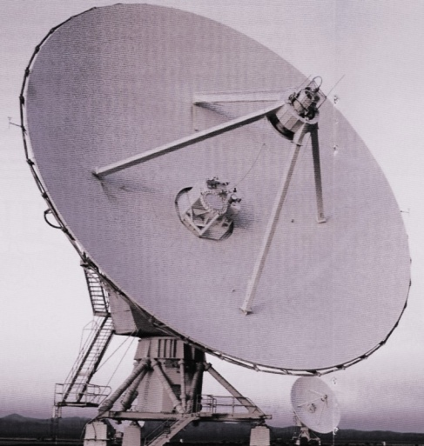
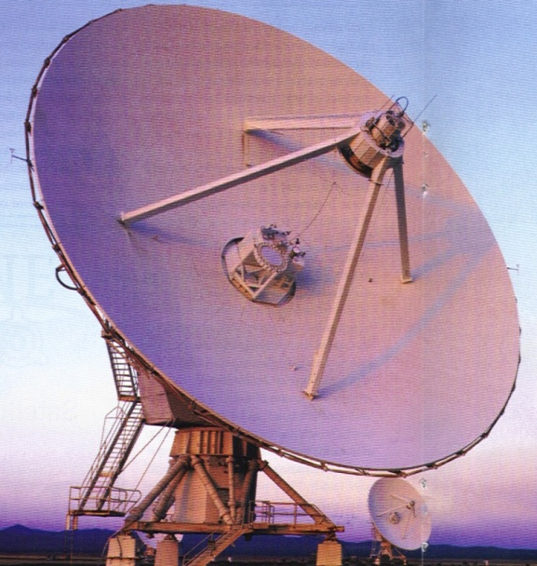
Types of Data
Image
  Raw
  Processed

Slide 55
Types of Data
Image
  Other Examples
    Fingerprint Recognition
    Arrangement of your photo albums on PC

Slide 56
Types of Data
Audio
  Raw: Conversation between people in cockpit of aircraft and Flight Controller recorded in Black box
  Processed: In case of air crash, the recorded audio will be converted to digital form, background noise will be removed, and the clarity of speech will be improved to assist investigators

Slide 57
Types of Data
Video
  Raw: Old Black and White movies
  Processed: Black and white movie made colored
  Raw: Any Video in foreign language
  Processed: Dub it in Urdu

Slide 58
Think and name any other form of Data.
  Other than numeric, text, image, audio, video
Think and describe in what ways can that form of Data be processed.

Slide 59
Concept Check
What are the two key components of information technology?
Notes:
Computers and communications

Slide 60
Concept Check
Arrange the five sizes of computers from largest to smallest?
Mainframe, microcomputer, microcontroller, supercomputer, workstation,,
Notes:
Supercomputer, mainframe, workstation, microcomputer, microcontroller

Slide 61
Concept Check
Which size of computer is also called an “embedded computer?”
Notes:
Microcontroller

Slide 62
Concept Check
What is the term for a computer used to hold collections of data and programs for connecting PCs, workstations, and other devices?
Notes:
Server

Slide 63
Concept Check
What is the difference between data and information
Notes:
Server

Slide 64
Who Uses Computers?
Military
Doctors
Educators
Engineers
Architects
Musicians
Filmmakers
Attorneys
Bankers
Architects

Slide 65
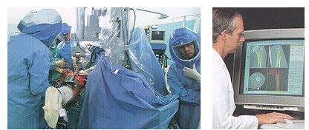
A medical team using “robodoc” to assist in surgery.

Slide 66
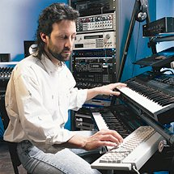
Musicians can use MIDI technology
to compose and edit their work.

Slide 67
Learning Objectives:
List at least five professions in which computers are routinely used, and describe at least on of the ways computers have affected the work of people in those professions.
List the four parts of a computer system.
Identify four kinds of computer hardware.
List the two major categories of software and explain the purpose of each.
List the four most common types of computers available today and describe what kind of job each does best.

